Slide 1
Conditional Statements

Slide 2
Decision Statements
Decision making structures require the programmer to specify one or more conditions to be evaluated or tested by the program, along with a statement or statements to be executed if the condition is determined to be true, and optionally, other statements to be executed if the condition is determined to be false.

Slide 3
Conditional Statements
If
If else
switch

Slide 4
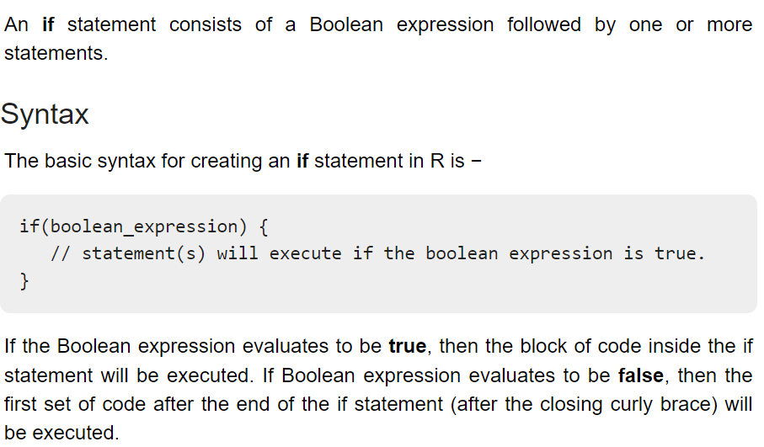
If statement

Slide 5
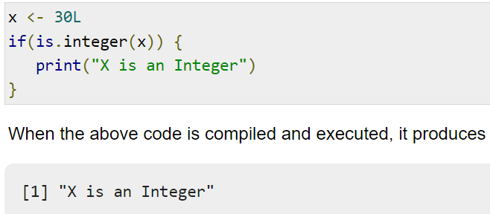
Example

Slide 6
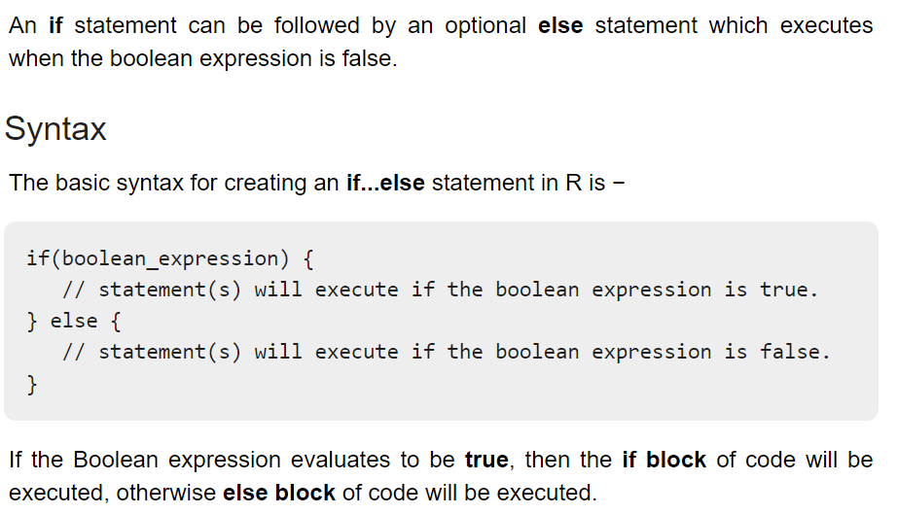
If else

Slide 7
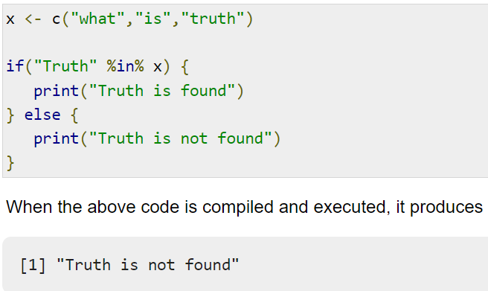

Slide 8
The if...else if...else Statement
An if statement can be followed by an optional else if...else statement, which is very useful to test various conditions using single if...else if statement.
When using if, else if, else statements there are few points to keep in mind.
An if can have zero or one else and it must come after any else if's.
An if can have zero to many else if's and they must come before the else.
Once an else if succeeds, none of the remaining else if's or else's will be tested.

Slide 9
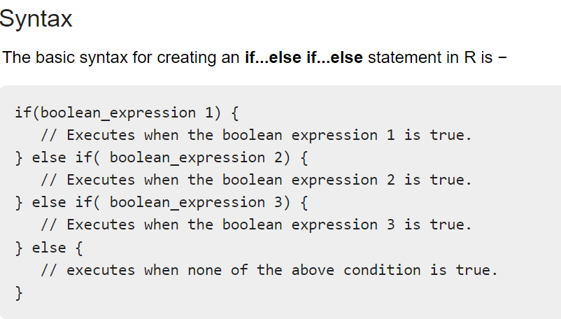

Slide 10
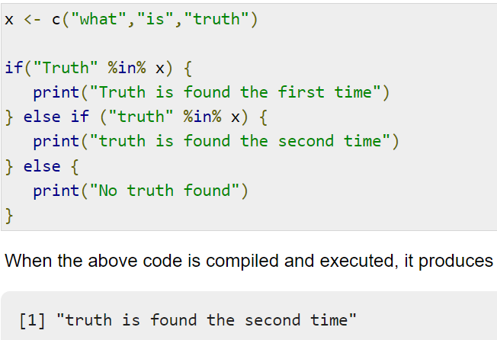

Slide 11
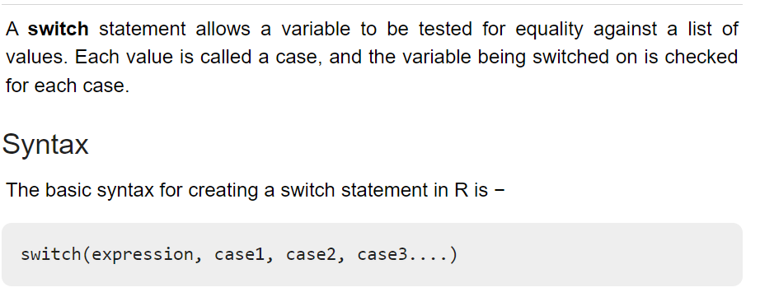
Switch

Slide 12
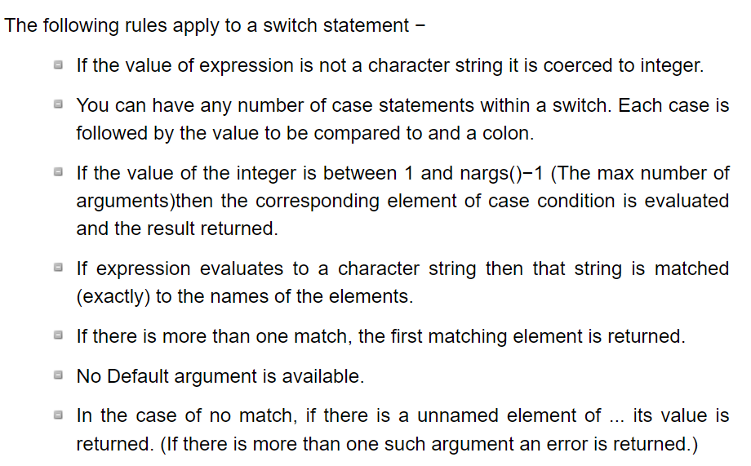

Slide 13
